Slide 1
Fungal Biology & Ecology
Fungal Molecular Community Data Analysis – 25.11.2024
Judith Riedo, Ph. D.
Juan F. Dueñas, Ph. D.
Notes:
Welcome to the exercise part of today’s lecture. The rest of the afternoon consists of three parts. First I will give you some background to the exercise and very quickly repeat some general concepts. Then I will go with you through the R-Script of today’s exercise and in the last part you will conduct the analysis in R yourself

Slide 2

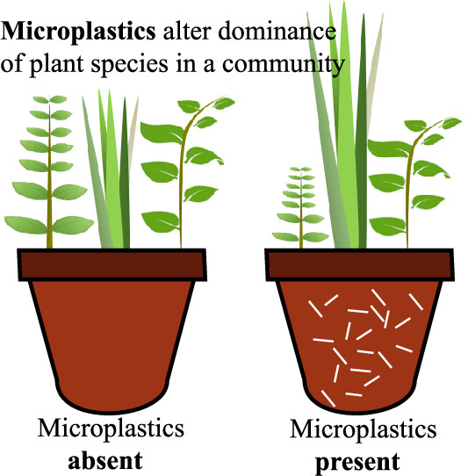
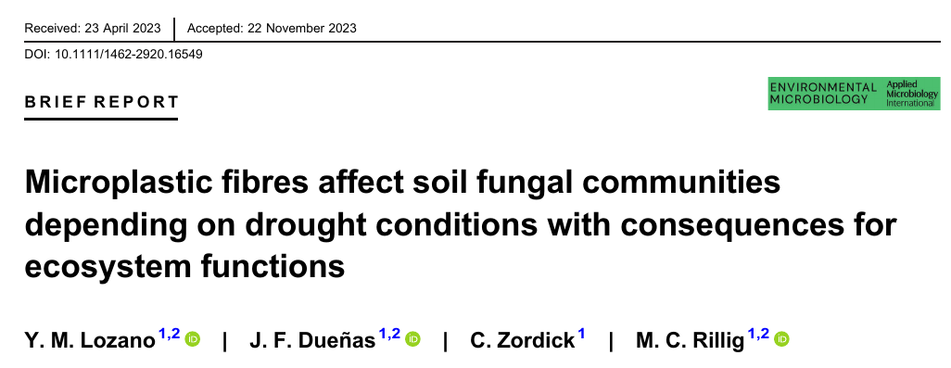

Background for Today’s Exercise
Publication by Lozano et al., 2023
Determining the individual and interactive effects of microplastic fibre addition and drought on overall fungal communities
Rizosphere soil collection
Environmental DNA extraction
Amplicon sequencing
Microplastic/ Drought | No | Yes
No
Yes
Lozano et al., 2023, Journal of Applied Ecology
Notes:
As preparation for this lecture, you should have all read the publication by Yudi Lozano and colleagues that looked at the individual and interactive effects of microplastic and drought effects on fungal communities. The factorial design contains four groups of samples, Pots with no microplastic or drought – so the control, pots with microplastic, pots with drought, and plastic. After two month the experiment was harvested and the rhizosphere soil - so the soil that remained attached to the roots after gentle movement - was collected. The DNA was extracted from the soil samples and the prepared and sent to amplicon sequencing

Slide 3
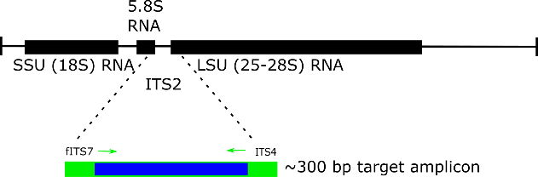
Data Pre-Processing
Amplification
20 samples
Normalization
Bioinformatics
1136
Amplicon Sequence Variants
Curation of errors
Clustering into taxonomic units
Mapping
Taxonomic ID + Ecological ID
Notes:
Amplicon sequencing is a method used to study specific parts of DNA, which helps identify and classify different species. For fungi the Internal Transcribed Spacer (ITS) region is used. Specific primers, so short pieces of DNA that match the beginning and end of the ITS region are used. They act like markers, telling the process exactly where to start and stop copying the DNA. Afterwards, PCR (Polymerase Chain Reaction) is used to make many copies of the ITS region. Once enough copies are made, they are sequenced (read) to determine the exact DNA sequence of the ITS region. Raw sequencing data is processed to filter low-quality reads and remove artifacts of PCR. Reads are clustered into Taxonomic Units such as Amplicon Sequence Variants (ASVs) based on sequence similarity. Each ASV represents a unique sequence and often corresponds to a specific microbial organism and are used as a proxy for species. These ASVs are then aligned or matched to a reference database.
For this setup in particular this process led to a dataset including 1136 ASVs, as well as the taxonomic and ecological IDs.
To identify and analyze fungal species the Amplicon sequencing of the ITS2 (Internal Transcribed Spacer 2) region is sequenced. For this, the region is first amplified by PCR using specific primers, and these amplicons/PCR products are then prepared for sequencing by attaching adapter sequences and barcodes. The prepared libraries are sequenced using platforms like Illumina, which generate short-read (300-500 bp) sequences of the ITS2 amplicons.
Raw sequencing data is processed to filter low-quality reads and remove chimeras (artifacts of PCR). Reads are clustered into Taxonomic Units such as Amplicon Sequence Variants (ASVs) based on sequence similarity. These units are compared to reference databases (e.g., UNITE) to identify species or higher taxonomic ranks.
For this setup in particular this process led to a dataset including 1136 ASVs, as well as the taxonomic and ecological IDs.

Slide 4
Community Ecology Data
Sample ID | Drought | Microplastic | Treatment
Sample 1 | No | No | Ctrl
Sample 2 | Yes | No | + D
Sample 3 | No | Yes | + M
Sample 4 | Yes | Yes | + D + M
Sample ID/ Taxon ID | ASV 1 | ASV 2 | ASV 3 | ASV 4
Sample 1 | 10 | 20 | 30 | 2
Sample 2 | 4 | 500 | 58 | 87
Sample 3 | 55 | 69 | 5257 | 221
Sample 4 | 100 | 546 | 687 | 2222
Taxon ID | Kingdom | Phylum | Guild
ASV 1 | Fungi | Ascomycota | Saprotroph
ASV 2 | Fungi | Basidiomycota | Pathotroph
ASV 3 | Fungi | Basidiomycota | NA
ASV 4 | Fungi | Glomeromycota | Symbiotroph
Notes:
So for you, this means that you have three data files. One with the ASVs for each sample, one with the background information on these samples, and one about the taxonomic information of the ASVs

Slide 5
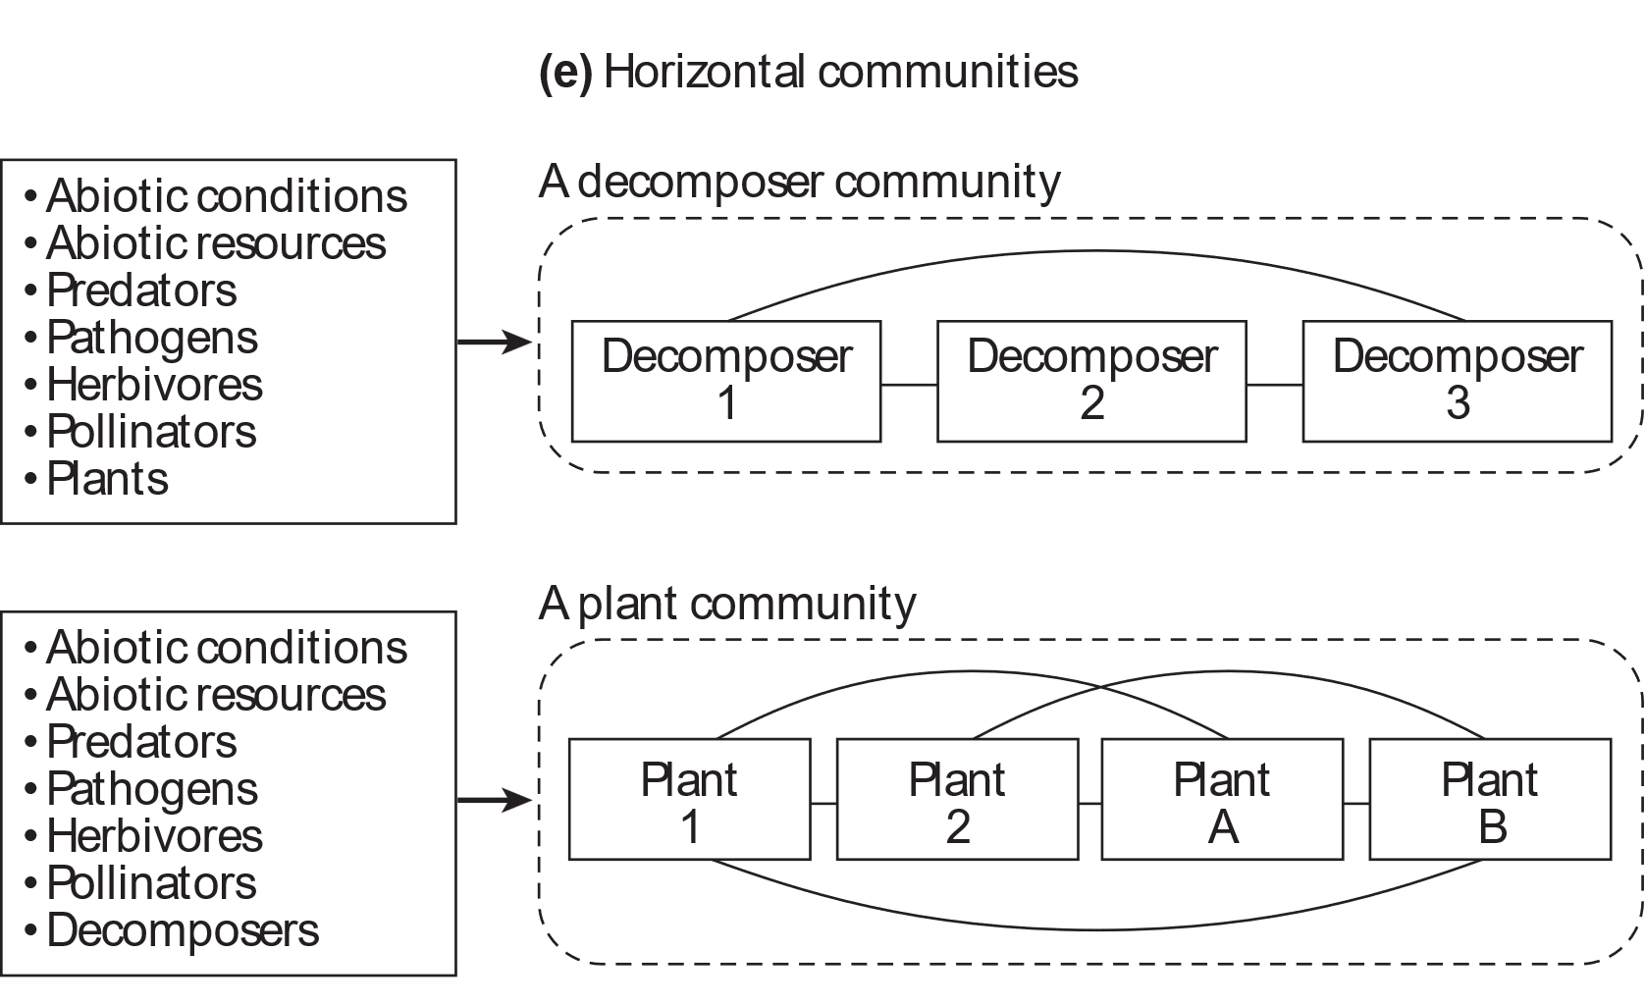
Definition of a Community
“A group of organisms representing multiple species living in a specified place and time”
Examples of communities:
A food web
A mutualistic network
A horizontal communities
→ A group of species at a particular trophic level or with common taxonomy
Vellend, 2016, The theory of ecological communities
Notes:
So what exactly are we looking at within this data set – We are interested in analyzing the communities within these samples. So all fungal species living in the soil sample at the time of the harvest.
There are different kinds of communities with different kinds of interaction between the species - such as a food web or a mutualistic community. In our case, we are interested in the horizontal community so all species at the same tropical level.

Slide 6
Attributes of a Community
How many? (alpha diversity)
Richness
Simpson dominance
Pielou’s Eveness
How different? (beta diversity)
Jaccard
Bray-Curtis
Site 1
Site 2
 | Species 1 | Species 2 | Species 3 | Species 4
Site 1 | 3 | 0 | 0 | 1
Site 2 | 0 | 2 | 1 | 0
Site 3 | 1 | 3 | 0 | 1
Site 3
Notes:
Our main interests of today’s exercise are two attributes of this community. Firstly we want to know how abundant certain species are within the community. So the richness of a species within one soil sample that represents the alpha diversity of a community. Secondly, we want to assess how the communities in the different samples are composed in relation to each other

Slide 7
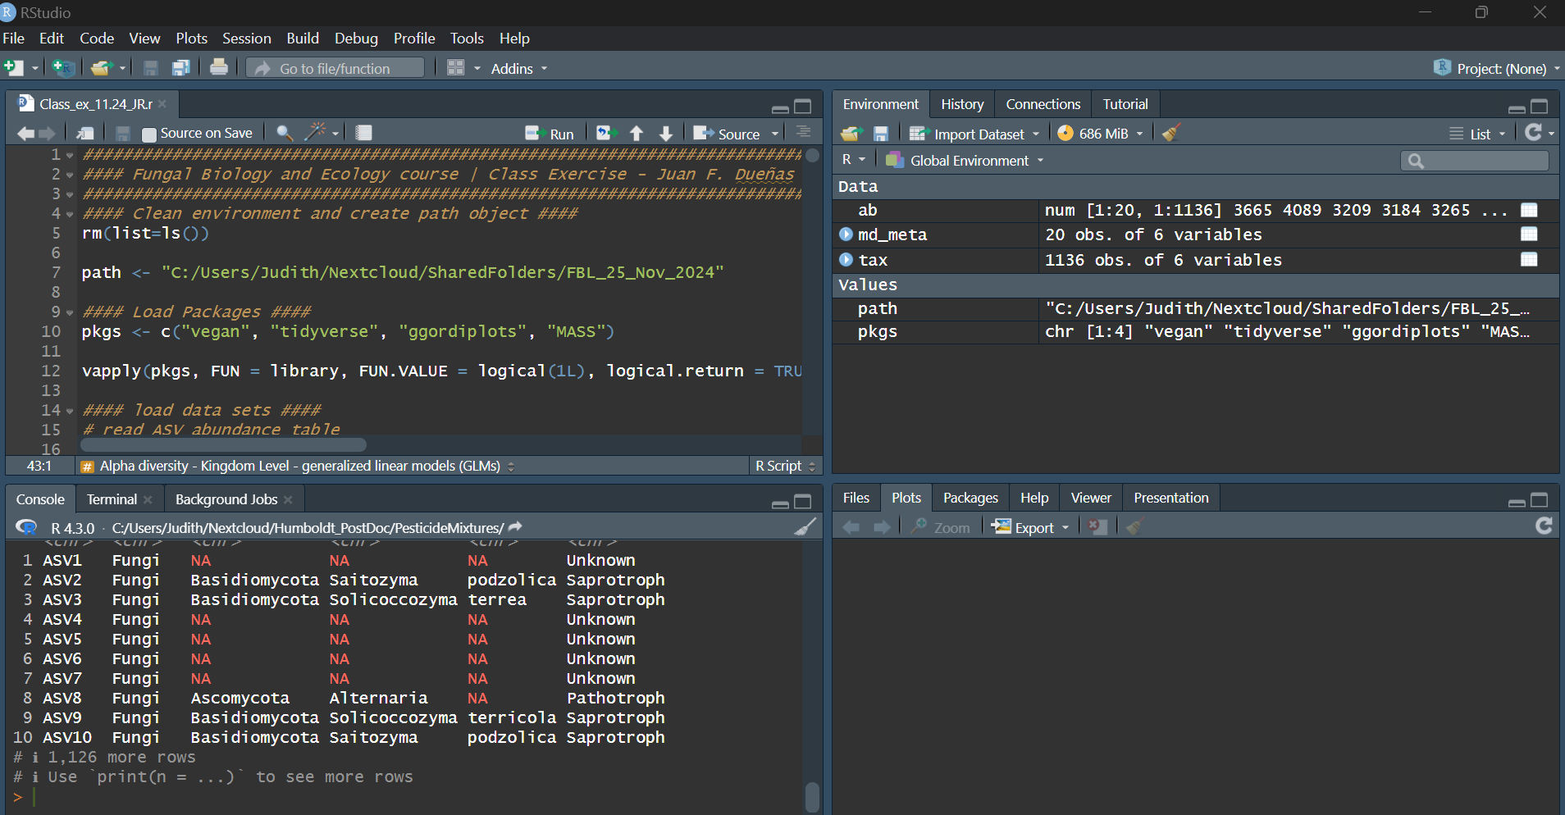
Introduction to Community Analysis in R

Slide 8
Class Exercise
Task: Try to do the alpha and beta analysis yourself, but focus on a specific fungal guild or phylum.
Group 1: Pathotrophs (also known as Pathogens)
Group 2: Symbiotrophs (mutualists like AMF)
Group 3: Saprotrophs (also known as decomposers)
Group 4: Ascomycota
Group 5: Basidomycota
Group 6: Glomeromycota
Hint: you need to cross the information on the tables we loaded at the beginning of the exercise.

Slide 9
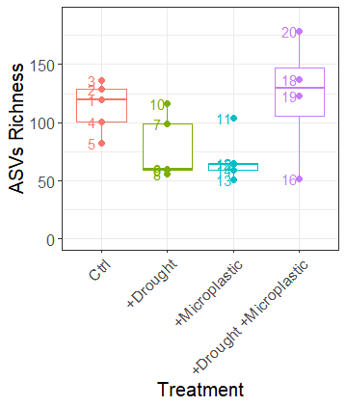
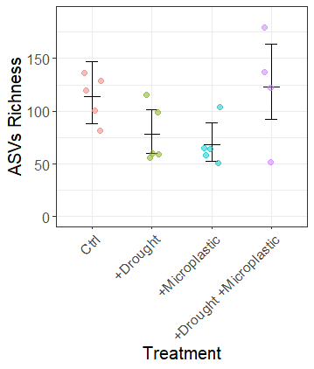
Results Fungi
Coefficients: | Estimate | Std. Error | z value | Pr(>|z|)
(Intercept) | 4.7327 | 0.1307 | 36.21 | <2.00E-16 | ***
drought | -0.376 | 0.187 | -2.011 | 0.04437 | *
microplastic | -0.5044 | 0.1879 | -2.684 | 0.007278 | **
drought:microplastic | 0.9578 | 0.2728 | 3.512 | 0.000445 | ***

Slide 10
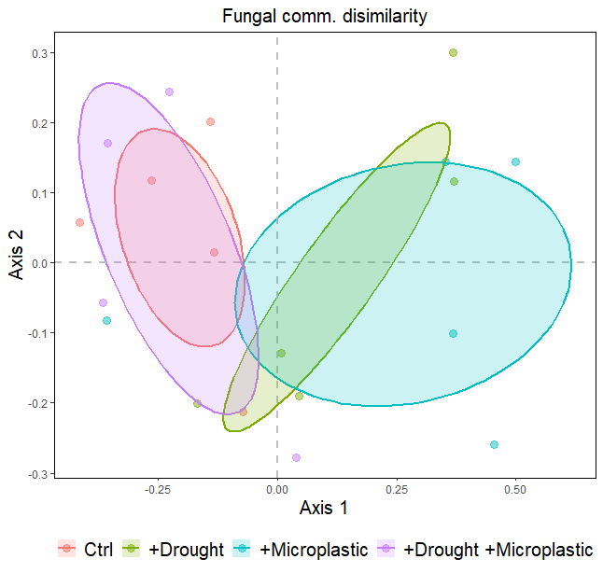
Results Fungi
 | Df | Variance | F | Pr(>F)
microplastic | 1 | 4.449 | 1.0015 | 0.399
drought | 1 | 4.506 | 1.0142 | 0.337
microplastic:drought | 1 | 6.672 | 1.5018 | 0.002 | **
Residual | 15 | 66.642

Slide 11
Microbial Communities – A Challenge
We are not sure what an individual or a species means in fungi
Taxonomy is incomplete or in a state of flux
We cannot easily count microbes
→ Reliance on molecular methods such as amplicon sequencing or meta-barcoding
Notes:
Studying microbial communities comes with unique challenges. In fungi, the concept of an individual or species is often unclear due to their complex and interconnected nature.
Taxonomy is another hurdle—it's incomplete and constantly changing as new discoveries reshape our understanding.
Counting microbes is also difficult; traditional methods like culturing capture only a small fraction of diversity. Instead, we rely on molecular techniques like amplicon sequencing or meta-barcoding, which analyze genetic material from environmental samples. While powerful, these methods have their own limitations, adding complexity to microbial research.

Slide 12
Limitations of Molecular Approaches
Is a taxonomic unit (e.g. ASVs) equivalent to a species?
→ No (Ryberg 2015. https://doi.org/10.1111/mec.13444)
Are taxonomic units reproducible?
→ Not always (Callahan et al. 2017 https://doi.org/10.1038/ismej.2017.119)
Is the abundance of reads equivalent to the abundance of an organisms in the environment?
→ Probably not (Gonzales-de-Salceda 2021 https://doi.org/10.1186/s40168-021-01111-z)
Notes:
No, a taxonomic unit such as an ASV (Amplicon Sequence Variant) is not always equivalent to a species, but it often serves as a proxy for species in ecological studies. Here’s why:
What is a Taxonomic Unit?
Taxonomic units, like ASVs or OTUs (Operational Taxonomic Units), represent distinct sequences or groups of sequences identified during the analysis of sequencing data.

Slide 13
Study Guide
At the end of this lab you will be able to answer the following questions:
What is a community and how can it be defined?
Which fundamental characteristics of a community can we measure?
Why it is important to study communities? Write your thoughts about it.
Which techniques are available to study communities of microbial organisms such as soil fungi?
What are the limitations of these techniques?
Does soil moisture content modulate the effects of microplastic fiber pollution on fungal communities?
What can metagenomics teach us about microbial communities?

